Slide 1
Science notebook training
Carol Wooten, M.Ed., NBCT
Hunter GT/AIG Magnet Elementary, Fifth Grade
Kenan Fellow
Presidential Awardee for Excellence in Math and Science Teaching
http://carolwooten.weebly.com

Slide 2
Goals
Gain an understanding of how to implement science notebooks in K-5 classrooms
Utilize a variety of methods to review science content

Slide 3
AGENDA
1. Overview of science notebook components through hands-on modeling and student explanations
2. Discussion of engaging methods to enrich science content

Slide 4
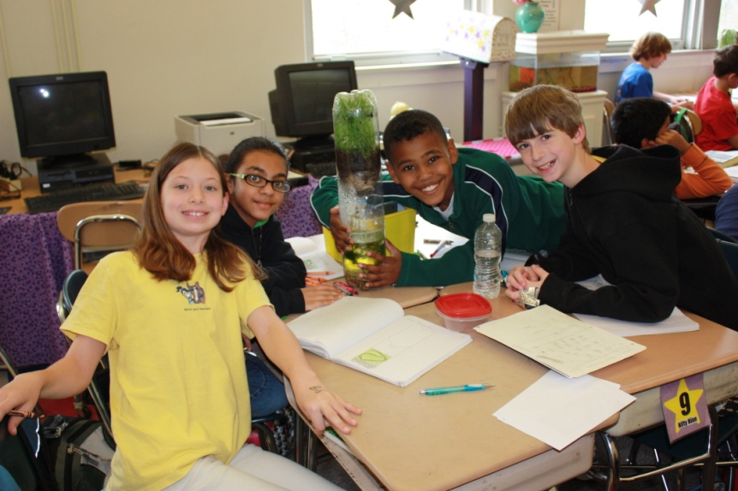
Science notebook components
Throughout the presentation, we will discuss how to implement science notebooks at various grade levels.
Each investigation will vary on the components needed in the notebook. For example, an ecosystems lesson may only include data/observation of the model ecosystem.
If you are just starting science notebooks, you can focus on a component and then work on including additional components in the notebook.

Slide 5
Implementation of science notebooks
An important stage of inquiry and of student science learning is the oral and written discourse that focuses the attention of the students on how they know what they know and how their knowledge connects to larger ideas, other domains, and the world beyond the classroom.
National Research Council, National Science Education Standards

Slide 6
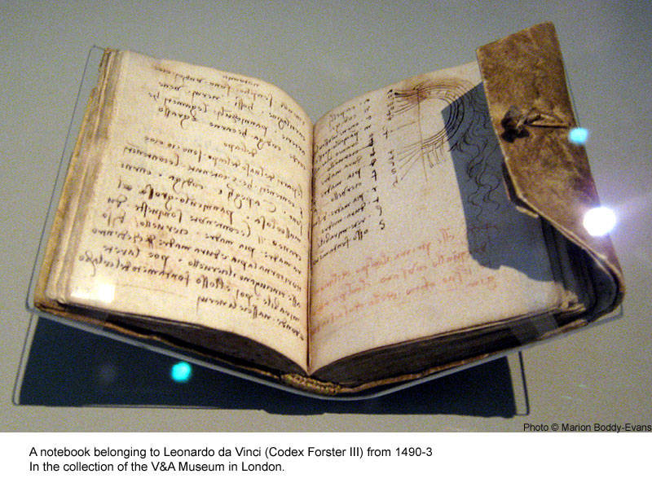
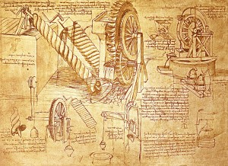
Leonardo da vinci’s science notebooks

Slide 7
Organization ideas
The type of notebook used is your choice. Kindergarten may have a class notebook. Grades 1-2 may use a binder while grades 3-5 may use marble composition notebooks.

Slide 8
Organization ideas
In upper grades, you can have students write on the right-hand side of the page only. Then, the left side can be used for content handouts or teacher comments.
Write the date and time of the investigation in the top right hand corner.

Slide 9
Organization ideas
You may store your notebooks in the classroom.
A science notebook poster helps students remember the components.

Slide 10
Organization ideas
You may also begin with a KWLH chart by completing the K (what I think I Know) and W (what I Want to know) portions.
This chart can be completed as the first part of the notebook or placed on note cards to display as a working bulletin board.
It is an excellent pre-assessment of students’ prior knowledge.

Slide 11
Focus question

Slide 12
Focus question
The focus question begins an investigation and relates to the investigation.
It usually starts with HOW or WHY.
Avoid questions that can be answered with a “yes” or “no” response.
Teacher may provide the focus question. In upper grades, students may be able to develop their own focus question when given an overview of the investigation.

Slide 13
Focus question example
This student writes his focus question and also includes a clarifying illustration.
What is the best way to roll the marble down the ramp?
First Grade

Slide 14
Cooperative team focus question
Overview of the task: Your team will be using the materials provided in the bucket to create a vehicle that will travel at least 100 cm.
Work with your cooperative team to develop a focus question for this investigation.
We will share these focus questions with the whole group.

Slide 15
Focus question: student work sample
How can we design a vehicle that will travel at least 100 cm?

Slide 16
focus question video review

Slide 17
prediction

Slide 18
prediction
The prediction relates directly to the focus question.
Sentence starters include “I predict that…because…” OR “If then…because…”
Students at all grade levels may include clarifying illustrations. However, younger grades may choose to use the illustrations only as their prediction.

Slide 19
prediction example
Prediction: “I think that if we use directions and materials provided then we can successfully build a model because we have analyzed the school yard.”
FOSS Landforms Kit

Slide 20
Cooperative team prediction
Select one of the options for your prediction:
A. Create an illustration for your prediction
B. Use one of the sentence starters (I predict that…because….” Or “If…then…because…”).
Share several of the predictions with the whole group.

Slide 21
prediction : student work sample
This student makes a connection between friction and riding her bike on the grass.

Slide 22
prediction : student work sample
This student made a connection between using the rubber band to power the vehicle and playing with a toy car.

Slide 23
prediction : student work sample
“I think the nervous system works by sending messages to your brain to let you think or feel a certain way that happened.”
This student is still working on the “because” portion, but includes an illustration for clarification.

Slide 24
Prediction video review

Slide 25
Data and observations

Slide 26
Data and observations
Data and observations can be in the form of a table, graph, chart, picture, or other graphic organizer.
The data and observations sections may be provided in a handout form for students to complete or students may create their own data collection tool.

Slide 27
Data and observations example
This first grade example shows how the student created an illustration for the data and observations section of the science notebook.
The data shows where clips and cups were placed on the ramp to make the marble travel the greatest distance.
First Grade

Slide 28
Cooperative team Data and observations
What type of data collection tools could be used with this investigation?
Brainstorm possible data collection tools with your table group.
Share these tools with the whole group.
Then, we will conduct the investigation.

Slide 29
Data and observations: student work sample
This student used illustrations to record her observations about the ramp. She noted the different ramps created for marble rolling. She notes that the data labeled “low” worked for her cooperative team.
First Grade

Slide 30
Data and observations: student work sample
Genetics Bar Graph

Slide 31
Data and observations: student work samples
Data Charts

Slide 32
Data and observations: student work samples
Observation with Data Table
and Graphic
Data Table Provided and Glued in Notebook

Slide 33
Data and observations: student work samples
Graph Based on Data Table
Venn Diagram

Slide 34
Data and observations: student work samples
Student Generated Graphic
Graphics with Data Table

Slide 35
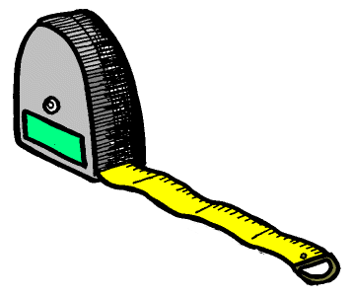
Data and observations video review

Slide 36
Making meaning conference

Slide 37
Making meaning conference
The investigation does not end with the collection of data.
Instead, each team will share findings from the investigation with the class.
The teacher will discuss observations he/she made during investigation time.
Introduce new vocabulary, show a review video, and/or take care of any misconceptions at this time.

Slide 38
Cooperative team Making meaning conference
Science teams will share findings from the investigation.
Use data to support discussion comments.
What did you discover during the investigation? What would the Making Meaning Conference look like for this investigation?
Based on your grade level, what type of content and vocabulary would you introduce following the investigation?

Slide 39
Making meaning conference video review

Slide 40
Claims and evidence

Slide 41
Claims and evidence
K-2nd: Students write what they learned from the investigation. Students can also draw an illustration.
3rd-4th: Students can use a t-chart with “claims” on the left side and “evidence” on the right side.
5th: Students can write their claims and evidence in sentence form. “I claim that…My evidence is…”
Note: Adjust how you complete this component based on your grade level and individual students. Illustrations to clarify claims and evidence statements are encouraged at all grade levels.
Teacher Hint: Make sure students are clear on opinion versus a claim. A claim is NOT an opinion.

Slide 42
Claims and evidence example
This student wrote, “I learned that if you roll it down it will go. But do not put the ramp straight.”
The student can verbally use the data illustration as evidence.
First Grade

Slide 43
Cooperative team claims and evidence
In your cooperative science team, write a claims and evidence statement to share with the whole group.
Remember, in claims and evidence, we are able to support our claims statements with specific evidence that is found in the data/observations section.

Slide 44
Claims and evidence: student work sample
Using a science notebook was new for this student.
She started with separating her claims and evidence statements to ensure she included both parts.

Slide 45
Claims and evidence : student work sample
Graphics were included with the claims and evidence statements to clarify understanding.

Slide 46
Claims and evidence : student work sample
This student used specific numerical evidence to support the claims statement.

Slide 47
Claims and evidence video review

Slide 48
conclusion

Slide 49
conclusion
The conclusion can take several forms.
Students look back to their prediction. They write if their prediction was correct, incorrect, or partially correct. Then, students will use specific data and observations as support.
In younger grades, students can summarize the lesson in a sentence or create an illustration as a summary. Non-writers may either draw or respond verbally.

Slide 50
conclusion example
Landforms
The student stated the prediction was correct. She then elaborated on why her prediction was correct by describing specific data events from the investigation.

Slide 51
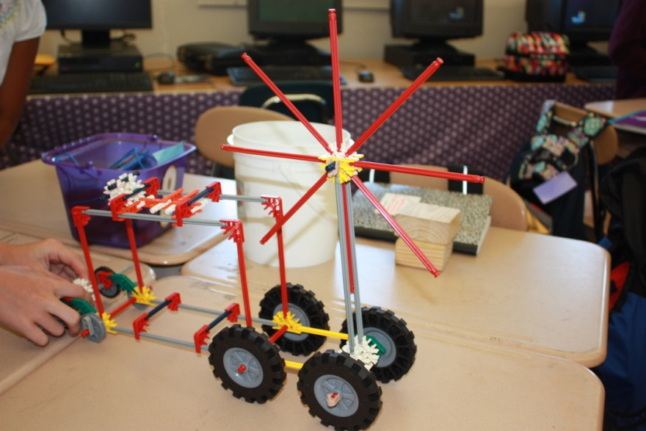
conclusion
Look back to your prediction and complete the conclusion component of the notebook.
Share your conclusion with a table partner.
We will also share several conclusions with the whole group.

Slide 52
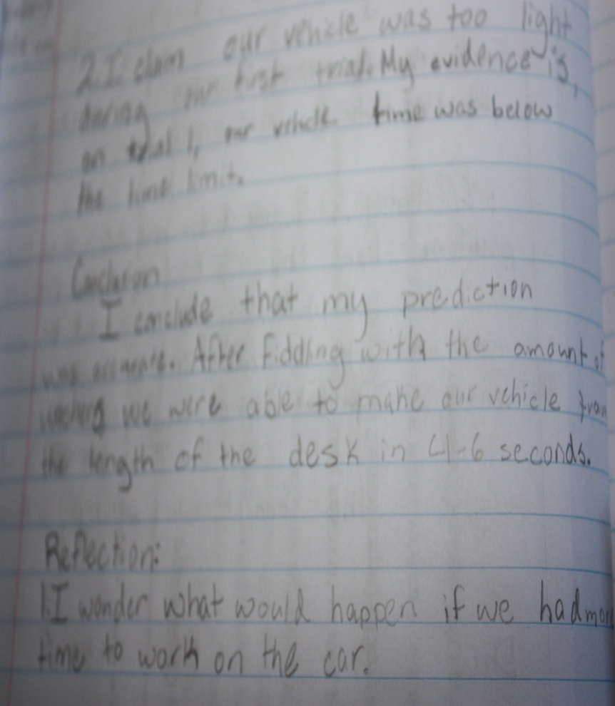
conclusion : student work sample
“I conclude that my prediction was correct. After finding the amount of washers we were able to move our vehicle the length of the desk in 4-6 seconds.”
Motion and Design

Slide 53
conclusion video review

Slide 54
reflection

Slide 55
reflection
In the reflection section, students explore next steps and new questions from the investigation.
What questions do you still have about the content?
If you were to continue the investigation, what else would you do to further investigate?

Slide 56
Reflection example
This student highlighted key vocabulary terms throughout the entire investigation.
The student used the “I wonder…” sentence starter.

Slide 57
Reflection
Based on the investigation, complete the conclusion component.
What questions do you still have about the lesson?
How would you further extend the lesson?
Share reflections with your table partner. We will share several reflections with the whole group.

Slide 58
Reflection : student work sample
What would happen if the sand and clay mixture were just clay?
What would happen if only clay was in the vial?
What would happen if the sand and clay mixture was just sand?
What would happen if there was no hole in the stream table tray?
Use of “What Would Happen If…” Sentence Starter

Slide 59
Reflection : student work sample
Examples:
I wonder what would happen if the string was a rubber band.
I wonder what would happen if we used different pieces for the car.
Reflection on Utilizing Different Types of Materials

Slide 60
Reflection video review

Slide 61
feedback

Slide 62
feedback
Throughout the investigations, the teacher circulates and listens to group discussions. He/she notes excellent points to discuss as well as misconceptions to address in the Making Meaning Conference.
Notebooks can be graded using rubrics that are provided or teacher created.
Comments can be made on Post-It notes in the notebook or written on the left hand side. Idea: Write positive comments in the notebook and areas for improvement on Post-It notes.

Slide 63
feedback
Feedback should be specific to help the student improve and/or maintain a high quality science notebook.
For example, rather than always writing, “Great job!,” the teacher can write “Your data is well organized and used to support your claims statements.” ☺ (varies by grade level)
Questions can be used to promote improvement. For instance, “What other information could be in your data table?”

Slide 64
Sample rubric

Slide 65
Sample rubric, page 1

Slide 66
Sample rubric, page 2

Slide 67
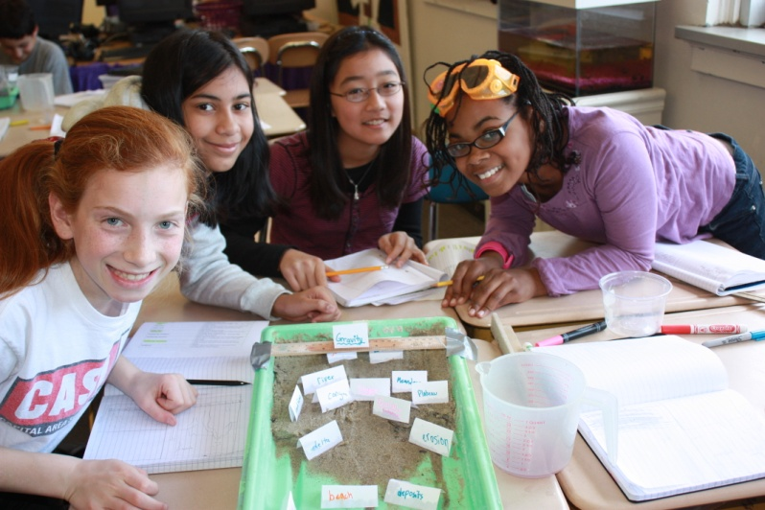
Strategic planning
With your grade level or specialist team, plan your next steps for implementing science notebooks.
What notebook components will you focus on for your science unit?
How will you provide feedback and assess notebooks?
Be prepared to share your ideas.

Slide 68
Vocabulary building

Slide 69
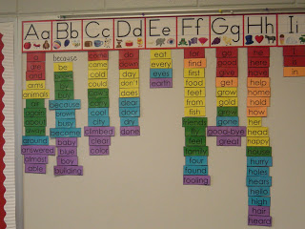
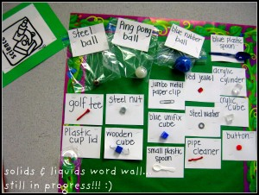
Word wall and realia wall
Word Wall
Realia Wall

Slide 70
Vocabulary four square
Go to http://carolwooten.weebly.com and click on the “Videos” link for directions on vocabulary four square.
The four square vocabulary activity focuses on the term, its meaning, an illustration, and connection.

Slide 71
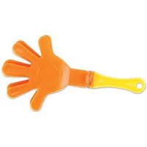
Whack-a-word

Slide 72
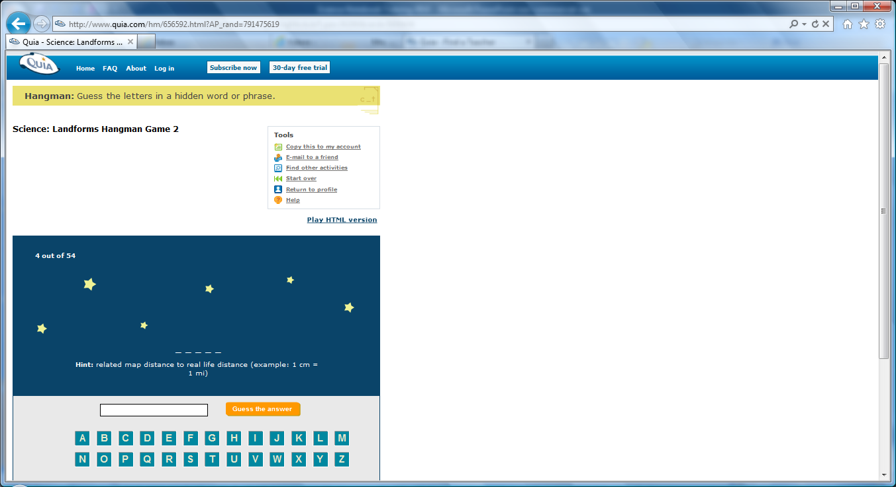
quia
Go to http://carolwooten.weebly.com and click on the Quia link.
This link is for fifth grade EOG preparation.
The Landforms Vocabulary Hangman game is for fourth grade students.

Slide 73
Drama and music integration
Students develop skits related to the science concepts. The teacher will provide guidelines and content to be covered in the skit. Record the skits to show to the class.
Create you own “Science Idol” competition where students use an appropriate song and change the lyrics to relate to the science unit.
This integration is appropriate at all grade levels.

Slide 74
“A science carol” EOG review strategies video
A Science Carol Synopsis: AN EOG TEST TAKING STRATEGIES VIDEO FOR STUDENTS
Sandy, a fifth grade student, is initially terrified of the science End of Grade (EOG) test. Through a daydream, Sandy is visited by three experts: the Teacher of Science Past, the Student of Science Present, and the Scientist of the Future. Sandy learns strategies such as the “Really Happy Students Do Well” mnemonic device to help her achieve her goals. As a student, how can you apply the strategies from the video on your science EOG?

Slide 75
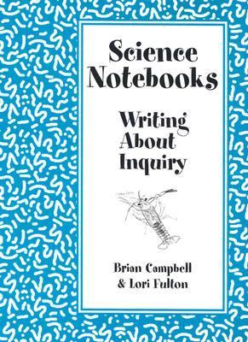
Resource sites
For teachers:
Science Notebooks: Writing About Inquiry by Brian Campbell and Lori Felton
Science Formative Assessment by Page Keeley
Active Assessment for Active Science by George E. Stein and Sabra Price

Slide 76
Finale video

Slide 77
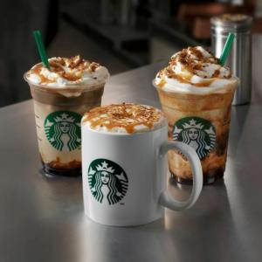
Door prize time
Make sure you have placed your name in the bin to win a door prize.
We will have TWO lucky winners. Each winner will receive a $5 Starbucks gift card. Good luck!

Slide 78
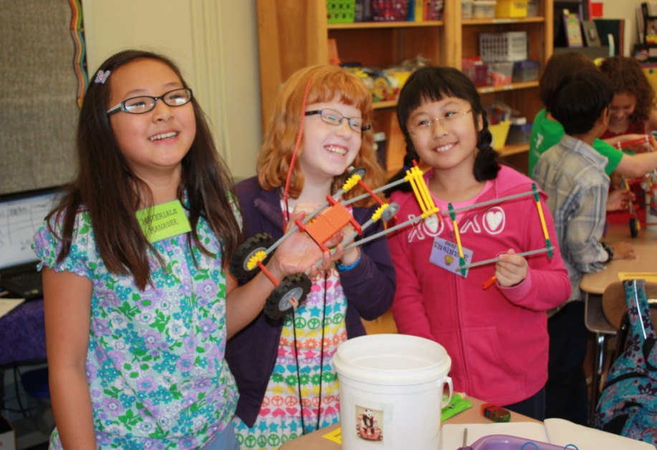
Thank you!
Thank you for attending Science Notebook Training.
If you have questions or need anything, feel free to contact me at cwooten@wcpss.net.

